Slide 1
MEPC IIJA Panel
Overview Slides
7/28/2022

Slide 2
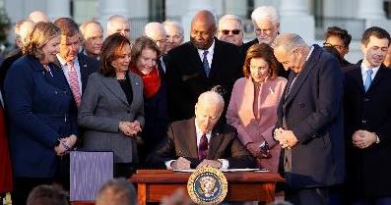
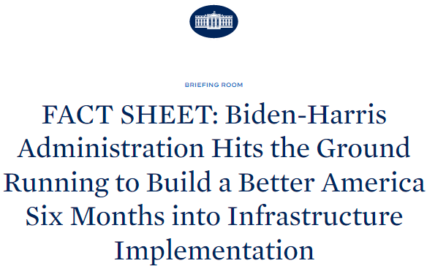
Bipartisan Infrastructure Law Implementation Updates
NOVEMBER 15, 2021
President Biden signs Bipartisan Infrastructure Law
MAY 15, 2022
180 Days into
BIL Implementation

Slide 3
Who qualifies for Bipartisan Infrastructure Law funding?
Communities
States and Tribes
Utilities
Industry
Manufacturers
Non-profits
Universities
K-12 Schools

Slide 4








Intergovernmental & External Affairs – Regional Specialists
Inter-Mountain West
(coming soon)
Spencer Thibodeau
Northeast
Jennifer Bumgarner
Principal Deputy Asst Secretary
Office of Congressional &
Intergovernmental Affairs
Rose Dady
Midwest
Rose Stephens-Booker
West (including HI and AK)
Torend Collins
Appalachia / Mid-Atlantic
Christian Bato
Southwest
Southeast
(coming soon)
Crystal Perkins
South-Central
Matt Dannenberg
Tribal Liaison
Office of Congressional &
Intergovernmental Affairs
Notes:
Rose D.

Slide 5

Collaborate.
Spencer Thibodeau,
Northeast
spencer.thibodeau@hq.doe.gov
Convene.
Torend Collins,
Appalachia / Mid-Atlantic
torend.collins@hq.doe.gov
Rose Dady,
Midwest
rose.dady@hq.doe.gov
Connect.
Crystal Perkins,
South
crystal.perkins@hq.doe.gov​
Regional Specialists
Christian Bato,
Southwest
christian.bato@hq.doe.gov
Contact Us:
DL-RegionalSpecialists@hq.doe.gov
Rose Stephens-Booker,
West
rose.stephens-booker@hq.doe.gov​
Matt Dannenberg
Tribal Liaison
matthew.dannenberg@hq.doe.gov​
Jennifer Bumgarner,
Principal Deputy Assistant Secretary
Office of Congressional & Intergovernmental and External Affairs
jennifer.bumgarner@hq.doe.gov
Notes:
Rose D.

Slide 6
DOE has already released $12B+ in funding
$3.1B to lower utility bills through energy efficiency home upgrades for
millions of Americans through DOE’s Weatherization Assistance Program
$3.1B to boost American battery manufacturing and supply chains
$2.4B to support commercial scale demonstrations of advanced
nuclear reactors
$2.6B to support carbon capture demonstration projects
$1.2B to prevent at-risk, carbon-free nuclear facilities from premature closure
$11.2M to support states design State Energy Security Plans
$1M to support small and medium manufacturing companies with
clean energy manufacturing improvements

Slide 7
Infrastructure Projects Create Jobs and Local Benefits
Community Focused
Domestic Manufacturing
Boosted
Renewable Energy Demonstrated
Rapidly and Equitably Deployed
GROWING THE CLEAN ENERGY ECONOMY

Slide 8

Hiring for the Clean Energy Corps
New DOE Jobs to Implement BIL Funding
Business Administration
Communications
Engineering
Finance/Accounting
Grants/Contract Management
Human Resources
Information Technology/Cybersecurity
Legal
Legislative Affairs
Physical Science
Program and Portfolio Management
Project Management
Public Policy
Safety and Occupational Health
Profiled Positions
Roles in Office of Manufacturing and Energy Supply Chains and State and Community Energy Programs:
-Stakeholder Engagement experts
-Workforce experts
-Small/Medium Business Development

Slide 9
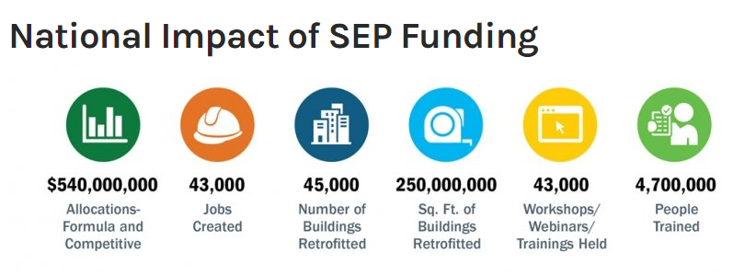
Expanding Programs for State and Local Benefits
State Energy Program (SEP)
Energy Efficiency Conservation Block Grants (EECBG)
Weatherization Assistance Program (WAP)

Slide 10
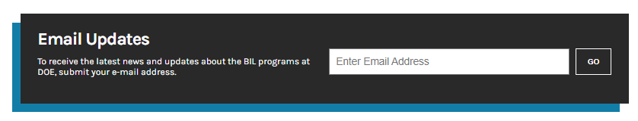

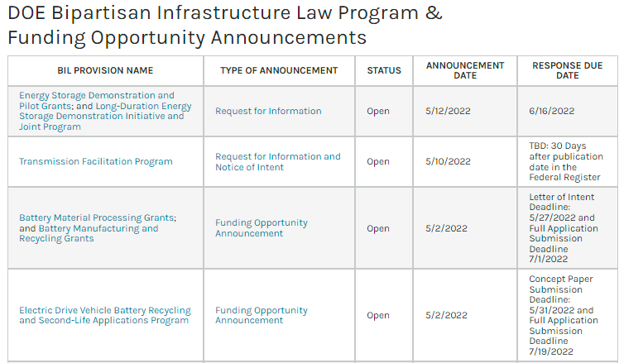

Resources
Visit energy.gov/bil for announcements and sign up for Bipartisan Infrastructure Law email updates.
Find funding opportunities and access detailed program information.
Browse Frequently Asked Questions (FAQs) for answers to commonly asked questions.

Slide 11
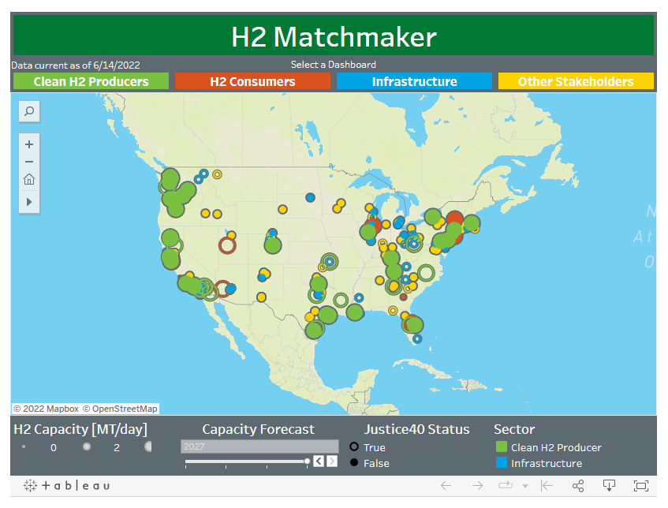
Public-Private-Partnerships form Clean Energy Industries
H2 Matchmaker is a new tool for hydrogen industry players to find one another and create partnerships on clean energy projects.
It connects hydrogen producers, end-users, and community stakeholders to self-identify their role in the hydrogen economy.
Click here to connect to the
H2 Matchmaker

Slide 12
Support for Michigan
January - Michigan received $384.7M in home energy assistance under the American Rescue Plan
February - hosted a State Listening Session to hear from states on their needs around BIL, five (5) attendees from Michigan’s PSC and Energy Office attended.
March - DOE issued $3.16B to support states to retrofit thousands of low-incomes homes to make them healthier and more energy efficient while lowering utility bills.
Full WAP allocation is $3.5B has not been issued
Early April – RFI for schools (due mid-May) – EV schools buses eligible and Building Codes (due in mid-May)
Late April – RFI for Preventing Outages and Enhancing the Resilience of the Electric Grid (responses were due in June)
May – two (2) FOAs for Battery Recycling and Use (concept papers due in late May)
July - EV Advisory Board Nominations due
August - State EV Infrastructure plans due to DOE

Slide 13
BIL Provisions – Energy Efficiency and Renewable Energy
Provision & Title | Title / Description | Details | Funding Type | Amount | Sector
40551 | Weatherization Assistance Program | Increase the energy efficiency of dwellings owned or occupied by low-income persons, reduce total residential energy expenditures, and improve health and safety, especially low-income persons particularly vulnerable such as the elderly, handicapped and children. | Formula | $3.5B | Residential
40552 | Energy Efficiency and Conservation Block Grant Program | Assist states, local governments and Tribes to reduce energy use, reduce fossil fuel emissions and improve energy efficiency. | Formula (block grants, with small portion of funds competitive | $550M | Residential and commercial
40541 | Energy Efficiency Improvements and Renewable Improvements at Public School Facilities | Provide energy efficiency, renewable energy and alternative fueled vehicle upgrades, and improvements at public schools. | Formula | $500M | Schools
40502 | Energy Efficiency Revolving Loan Fund Capitalization Grant Program | Capitalization grants to states to establish a revolving loan fund under which they can provide loans and grants for commercial and residential energy audits concerning the use and efficiency of energy. | Formula - States can provide grants for TA available for low-income individuals | $250M | Residential and commercial
Notes:
40109 to note: Collaborative Transmission Siting – Mandatory State Energy Office requirement via SEP to conduct electric transmission and distribution planning (among the conditions for $500 million in funding), including feasibility studies and outreach to stakeholders.
Energy Security/Resiliency Plan BIL requirements

Slide 14
BIL Provisions – Energy Efficiency and Renewable Energy
Provision & Title | Title / Description | Details | Funding Type | Amount | Sector
40511 | Cost-effective Codes Implementation for Efficiency and Resilience | State agency, State building code agency, State energy office, or Tribal energy office | Formula | $225,000,000 – $45,000,000 per year until expended for each FY 2022-2026 | Residential and commercial
40503 | Energy Auditor Training | State agency, State building code agency, State energy office, or Tribal energy office May partner with local building code agencies, codes and standards developers, associations of builders and design construction professionals, local and utility energy efficiency programs, and consumer, energy efficiency and environmental advocates | Competitive and formula (sed on population of eligible state and not to exceed $2M / per state | $40M | Commercial
40521 | Expansion of Industrial Assessment Centers |  | Competitive | $550M | Industrial
40209 | Advanced Energy Manufacturing and Recycling Grant Program |  | Competitive | $750M | Industrial
40534 | State Manufacturing Leadership |  | Competitive | $50M | Industrial
Notes:
40109 to note: Collaborative Transmission Siting – Mandatory State Energy Office requirement via SEP to conduct electric transmission and distribution planning (among the conditions for $500 million in funding), including feasibility studies and outreach to stakeholders.
Energy Security/Resiliency Plan BIL requirements

Slide 15
BIL Provisions – Electric Grid
Provision | Title | Key Detail(s) | Funding Type | Amount | Lead Office
40101 | Grid Infrastructure, Resilience, and Reliability | Supports activities to reduce the impacts to the electric grid due to extreme weather. | Formula - includes population, land area, and the historical precedence for experiencing disruptive events. | $5 billion for FY22-FY26 | States, tribes and territories
40103b | Upgrading Our Electric Grid and Ensuring Reliability and Resiliency | Program for states, tribes, PUCs and local governments for transmission, storage, and distribution hardening and regional grid resilience. | Competitive | $5 billion for FY22-FY26 | State, combination of 2 or more states; Indian Tribes; units of local government, and/or PUCs
40103c | Energy Improvement in Rural and Remote Areas | Uses: (A) Overall cost-effectiveness of energy generation, transmission or distribution systems; (B) siting or upgrading transmission and distribution lines; (C) reducing greenhouse gas emissions from energy generation by rural or remote areas; (D) providing or modernizing electric generation facilities; (E) developing microgrids; and (F) increasing energy efficiency. | Competitive | $1 billion for FY22-FY26 | Industry partners, utilities, national laboratories, universities, State and local governments, community based organizations, Tribal, and environmental groups
40106 | Transmission Facilitation Program and Fund | Allows DOE to serve as an “anchor tenant” for a new transmission line or an upgrade of an existing line. | N/A | $2.5 billion RLF – available until expended
40107 | Deployment of Technologies for Grid Flexibility - Smart Grid Investment Matching Grant Program | Amends Energy Independence and Security Act of 2007 to include Smart Grid investments | Competitive | $3 billion for FY22-FY26 | Investor-owned and municipality-owned utilities, and rural electric cooperatives.
Notes:
NOTE: Most of these require match

Slide 16
BIL Provisions – Electric Grid (2)
Provision | Title | Key Detail(s) | Funding Type | Amount | Lead Office
41001a | Energy Storage Demonstration Projects | Authorizes funding for the Energy Storage Demonstration Projects and Pilot Grant Program authorized by the Energy Act of 2020. | Competitive | $355 million for FY 22-25 | Technology developers, industry, State and Local governments, Tribal organizations, community based organizations, national laboratories, universities and utilities.
41001b | Long-Duration Demonstration Initiative and Joint Program |  | Competitive | $150 million for FY22-25 | Technology developers, industry, State and Local governments, Tribal organizations, community based organizations, national laboratories, universities and utilities.
40104 | Utility demand response | Each electric utility shall promote the use of demand-response and demand flexibility practices by commercial, residential and industrial consumers to reduce electricity consumption during periods of unusually high demand. | N/A | N/A

Slide 17
BIL Provisions – Sustainable Transportation
Provision & Title | Title / Description | Key Detail(s) | Funding Type | Amount | Eligible Entity
40541. | Energy Efficiency Improvements and Renewable Improvements at Public School Facilities | Allows funding for EVSE | Formula | $500M | BTO
40511. | Cost-effective Codes Implementation for Efficiency and Resilience | EV-ready codes | Formula | $225M | BTO
25006 | Federal Agency EV Joint Office Working Group (DOT and DOE) – state TA (no $) | DOT, DOE and EPA | Technical assistance | N/A | VTO
40112 | V2G and Battery Recycling - (subset of program includes grants to states to help with recycling efforts) | Part of larger R&D program | Formula | $50M | VTO
40431 | Electrification of the transportation sector (e.g., rate design to support EV charging usage) | PUCs | Technical assistance | No funding | VTO
Notes:
American Samoa = Renewable Energy and EV Charging Stations

Slide 18
Upcoming Funding Announcements
Carbon Storage Validation & Testing
Rare Earth Elements Demonstration Facility
Rare Earth Mineral Security
Solar Energy RD&D
Enhanced Geothermal Systems Demos
Direct Air Capture Hubs
Three grid upgrade/modernization programs
Hydropower RD&D
State Energy Program
Energy Efficient Transformer Rebate Program
Extended Product Systems Rebate Program
EE and Renewable Improvement at Public School Facilities
Carbon Capture Technology Program, Front-End Engineering and Design
Regional Clean Hydrogen Hubs
Clean Hydrogen Manufacturing Recycling RD&D Program
Clean Hydrogen Electrolysis Program
Energy Storage Demonstration Projects
Long Duration Demonstration Initiative
Energy Improvement in Rural and Remote Areas
Critical Material Innovation, Efficiency and Alternatives
Marine Energy RD&D
And more to come in Fall 2022!
To receive updates on all funding announcements subscribe at:
Energy.gov/BIL
Q2
Formula awards, all others competitive solicitations

Slide 19

Bipartisan Infrastructure Law Funding for Utilities
Carbon Capture Demonstration Projects Program
Carbon Capture Large-Scale Pilot Projects
Carbon Storage Validation and Testing
Carbon Utilization Program
Cybersecurity for the Energy Sector Research, Development, and Demonstration Program
Energy Efficient Transformer Rebates
Energy Sector Operational Support for Cyberresilience Program
Energy Storage Demonstration and Pilot Grants
Long Duration Demonstration Initiative
Modeling and Assessing Energy Infrastructure Risk / Advanced Energy Security Program to Secure Energy Networks
Power marketing administration transmission borrowing authority
Program Upgrading Our Electric Grid and Ensuring Reliability and Resiliency
Pumped Storage Hydropower Wind and Solar Integration and System Reliability Initiative
Regional Clean Hydrogen Hubs
Regional Direct Air Capture Hubs
Rural and Municipal Utility Advanced Cybersecurity Grant and Technical Assistance Program
Smart Grid Investment Matching Grant Program

Slide 20
Upcoming Announcement Focus
Hydrogen Hub NOI
$8B for H2 Hubs connecting H2 producers, transport, and end use
Funds hubs with geographic and feedstock diversity including solar, wind, and nuclear
State Energy Program and Energy Efficiency Community Block Grants
Formula funding going out to Cities, Counties, and States
Grid Resilience and Investment Programs
$10B for investments in grid resiliency, smart grid programs, and innovative transmission technology/plans
FOA coming later this summer/early fall
EECBG funding can be used for specific set of criteria
Formula to be released soon, with funding info early fall
DOE will support with technical assistance and model projects
Available for states, regional groups, local gov’ts, tribes, PUCs, utilities
RFI to be released later in the Summer

Slide 21
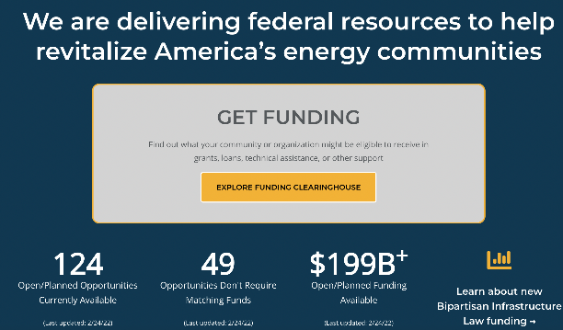
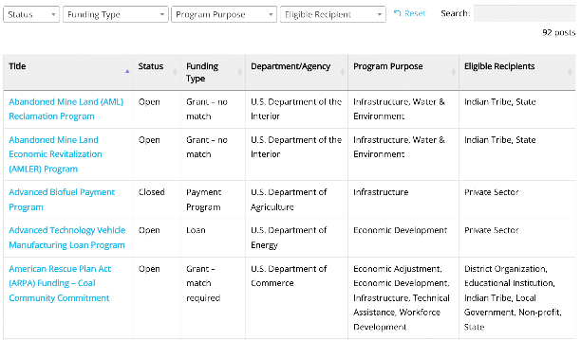
IWG Clearinghouse:
Doorway to BIL Opportunities for Energy Communities
$199B+ Value of Open/Planned Ongoing Appropriation Opportunities
124 Open/Planned Ongoing Appropriation Opportunities | 12 Agencies Represented | 49 Opportunities w/ no cost share
Dozens of new opportunities coming with the new Bipartisan Infrastructure Law (BIL)
https://energycommunities.gov/funding
Notes:
Discuss the purpose of the clearinghouse and provide a high-level overview of what’s currently included: summary statistics (number of agencies, number of opportunities, total dollar amount available, etc.)
There are many more opportunities coming from the bipartisan infrastructure law as new programs and funding are announced beyond those currently identified as planned.

Slide 22
Thank You!
For all Infrastructure Bill-related question please reach out to your regional specialists:
rose.dady@hq.doe.gov
Interagency Working Group on
Coal and Power Plant Communities and Economic Revitalization:
EnergyCommunities.gov
@EnergyComm_US
@EnergyCommunitiesUS
@energycommunitiesus

